Slide 1










SP MultiPort Download Tool User Guide
Internal Use
2016/07/26
ACS7/ST
Copyright © MediaTek Inc. All rights reserved.

Slide 2
Content
Feature introduction
Scan com port
Image checksum verify

Slide 3
Feature introduction
Internal Use
Copyright © MediaTek Inc. All rights reserved.

Slide 4
Feature introduction
Get started
Download Type
Download speed
Battery option
Auto polling
Checksum level

Slide 5
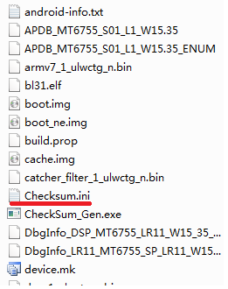
Get started
Step1: make sure the checksum.ini of SW image has been generate
Step2: select Download agent
Step3: select scatter file
Step4: configure the battery option
Step5: select how many phones to download at the same time
Step6: Scan com port
Step7: click the start button to download
Step8: plug in the phone which has been powered off
step1

Slide 6
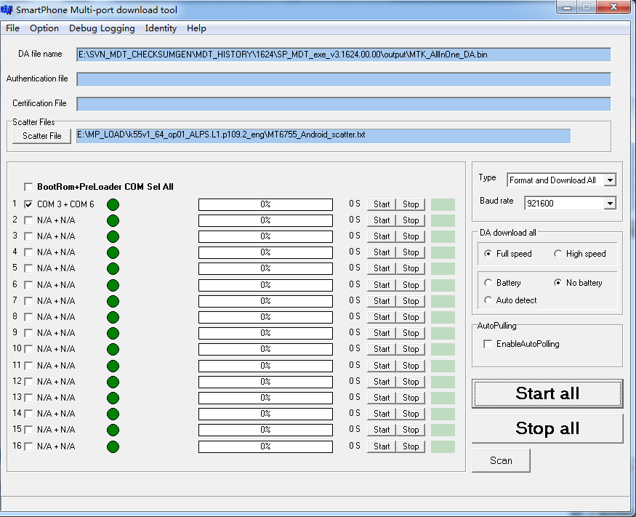
step2
step3
step5
step4
step7
step6

Slide 7
Download Type
Format and Download All
  Format whole flash and download all the image
Format all
  Format whole flash
  Firmware upgrade
  Calibration data will be keeped, other partition will be format and download all the image
Format bootloader
  format preloader only

Slide 8
Download speed
Full speed(usb1.1)
  Will do nothing
High speed(usb2.0)
  will check usb speed, if it’s full speed, it will change to DA high speed port

Slide 9
Battery option
Battery
  The power support sourc is battery
No battery
  The power support source is usb, tool will enable charger to get power from usb
Auto detect
  Tool will detect if battery exists, then choose which power source
  if yes, choose battery
  if not, choose usb

Slide 10
Auto polling
If enable, the tool will start the download again automaticly each time finishing the download.

Slide 11
Checksum level
Disable checksum
  Will not do checksum when download
Enable usb+dram checksum
  Keep the data’s integrity, the progress from pc dram to phone dram
Enable flash checksum
  Keep the data’s integrity, the progress from phone dram to phone flash
Enable checksum all
  Do the both usb+ dram and flash checksum, keep the data’s integrity, the progress from pc dram to phone flash
  Note:the checksum will takes more time when download

Slide 12
Scan com port
Internal Use
Copyright © MediaTek Inc. All rights reserved.

Slide 13
Scan com port
Before the download, you should scan the com port
Why scan com port?
After that there is no need to scan com port each download, which can make download more stable and a little quicker

Slide 14
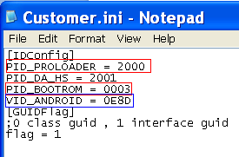
自动扫口—介绍(before MT6737)
扫口原理：
  插入设备时，先扫Bootrom com，然后通过bootrom下载DA到手机，接着DA run起来后枚举出Preloader Com，以便达到同时扫出Bootrom com和Preloader Com的目的
扫口前准备：
  使用W1308版本或者之后的MDT tool
  [MUST]选择与MDT对应版本的DA和设备对应的Scattere file
  准备一只没有下载过的USB设备，即空机，插入USB即可触发进入扫口。
  注：如果没有空机并且设备有接出Kcol0下载触发按键，则也可以通过压下Kcol0来触发进入扫口。
MDT Tool如何识别Bootrom口和Preloader口
  工具根目录的配置文件Customer.ini
  Vid&Pid如右图：
    Bootrom为0E8D&0003
    Preloader为0E8D&2000

Slide 15
自动扫口—介绍(MT6737&After)
扫口原理：
  从MT6737开始，支持自动识别口进行扫口功能，即不局限于空板或者按download key进行扫口。插入设备时，会根据枚举出来的口自动识别进行扫口。
    如果插入设备出来为preloader com，工具会先扫preloader com，然后通过preloader将DA下载到手机，接着DA run起来后枚举出bootrom com，以便同时扫出bootrom com和preloader com的目的。
    如果插入设备出来为bootrom com，工具会先扫bootrom com，然后通过bootrom下载DA到手机，接着DA run起来后枚举出preloader Com，以便达到同时扫出bootrom com和preloader Com的目的。
扫口前准备：
  使用W1728版本或者之后的MDT tool
  [MUST]选择与MDT对应版本的DA和设备对应的Scattere file
MDT Tool如何识别Bootrom口和Preloader口
  工具根目录的配置文件Customer.ini
  Vid&Pid如右图：
    Bootrom为0E8D&0003
    Preloader为0E8D&2000

Slide 16
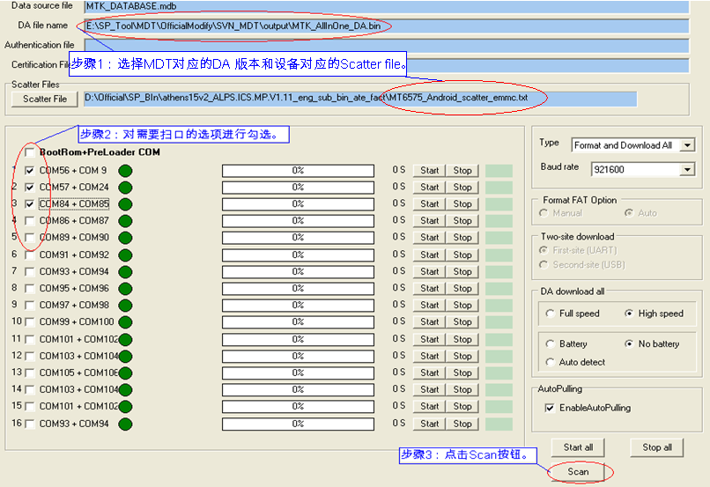
自动扫口—步骤（1）

Slide 17
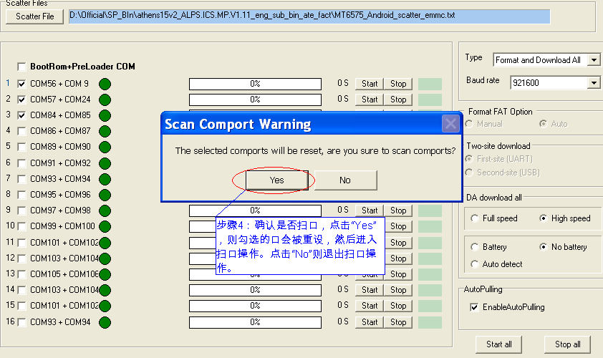
自动扫口—步骤（2）

Slide 18
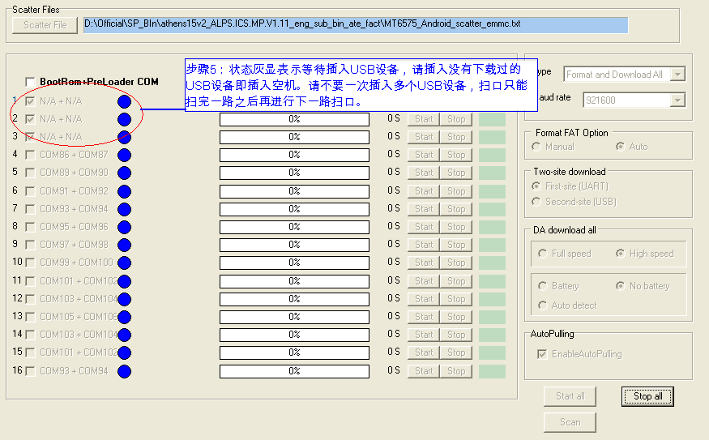
自动扫口—步骤（3）
Note：针对MT6737以及之后的平台，使用的手机不局限于空板，也可以使用有软件的手机进行扫口。

Slide 19
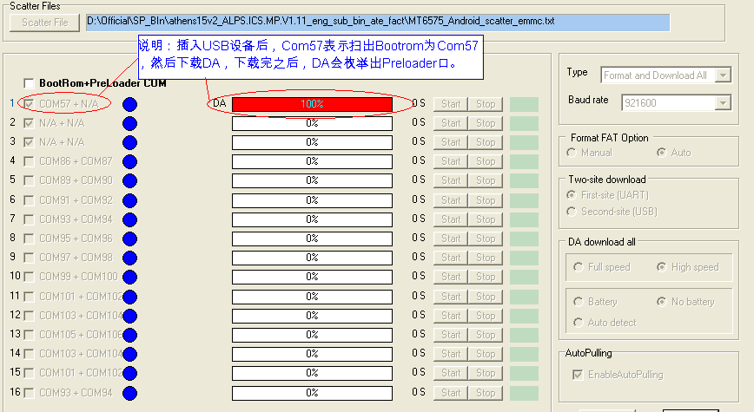
自动扫口—步骤（4）

Slide 20
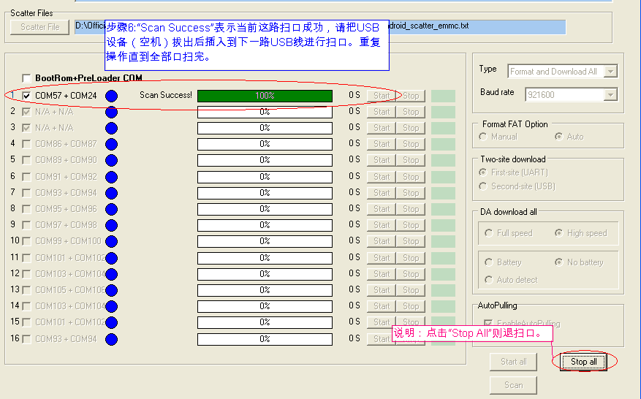
自动扫口—步骤（5）

Slide 21
Image checksum verify
Internal Use
Copyright © MediaTek Inc. All rights reserved.

Slide 22
Image checksum verify
In order to keep the image in pc disk is correct, the tool will verify the image after click the start button.
Pls make sure that the checksum.ini is together with the SW load under the same directory.

Slide 23
How to generate checksum.ini?
Step 1: get the checksum_gen.exe
-the checksum_gen.exe is released with SP Multiport Download Tool from MTK online
Step 2: generate checksum.ini
-put the checksum_gen.exe together with SW load, and start the checksum_gen.exe
Note1:pls make sure that the version of checksum_gen tool is the same as SP Multiport Download Tool.
Note2: it’s better to generate the checksum.ini immediately after the SW load built, the src code of checksum_gen support linux os.

Slide 24
FAQ
Internal Use
Copyright © MediaTek Inc. All rights reserved.

Slide 25
FAQ
问：除了自动扫口，是否可以在SPMultiPortFlashDownloadProject.ini对comport口进行配置？
  答：可以。

Slide 26
Thanks
Internal Use
Copyright © MediaTek Inc. All rights reserved.

