Slide 1
M150 SNViewer Ver 1.3.0
– Belarus Version

Slide 2
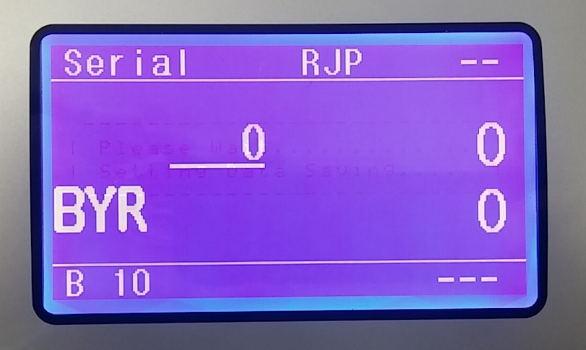
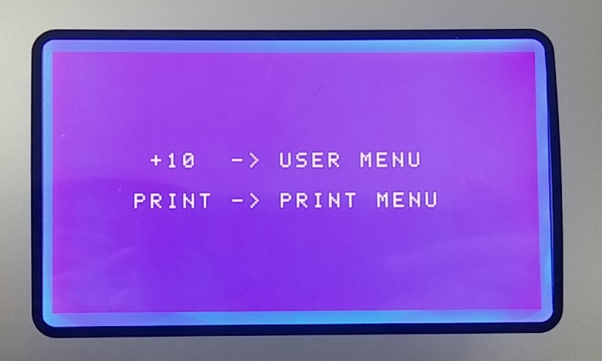
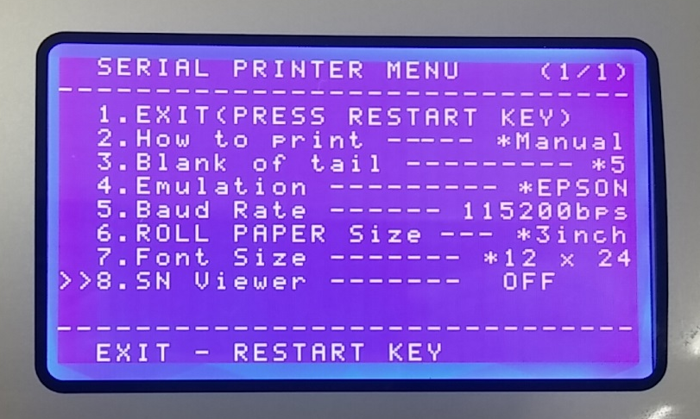
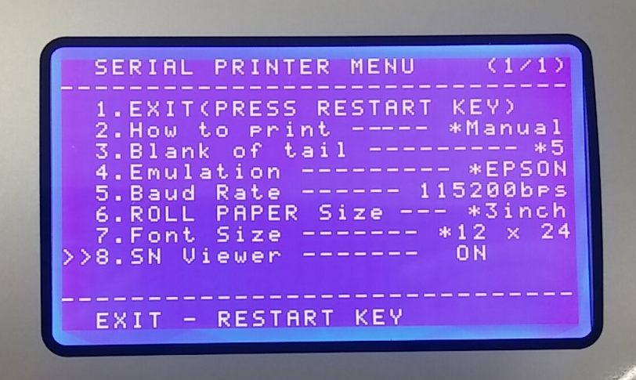
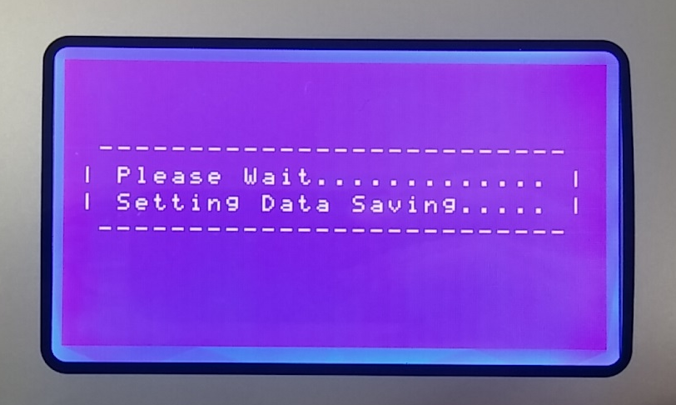
1. Enter BYR Serial Mode and long press ▲/+10 key.
2. Press PRINT key.
3. Go to 8. SN Viewer and select ON.
4. Press RESTART key and exit menu.

Slide 3
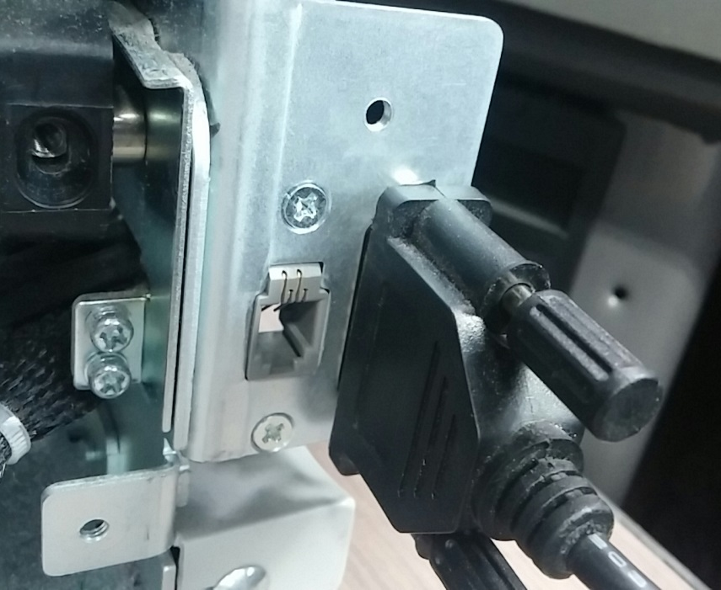
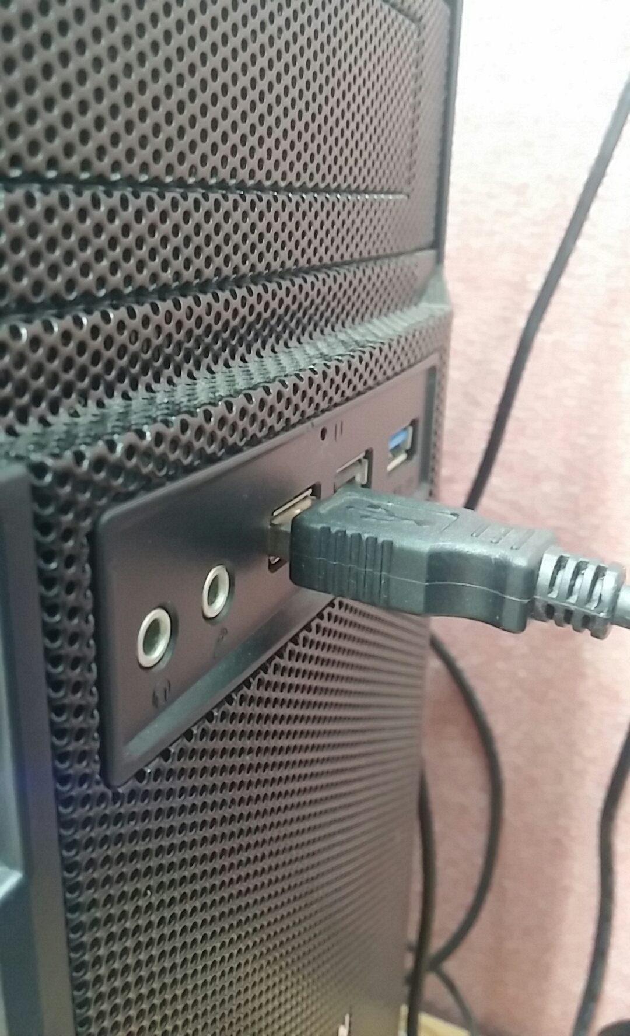
Connect USB-Serial Cable between M150 and PC.
USB Driver for this cable must be installed to PC first.

Slide 4
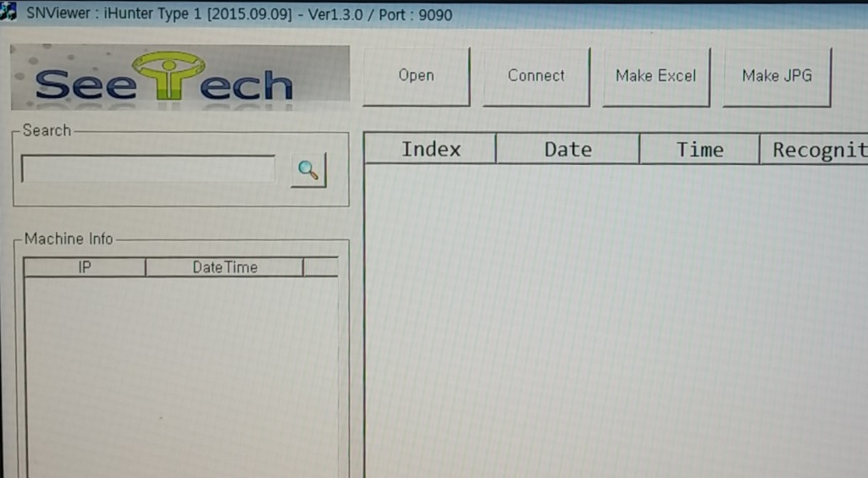
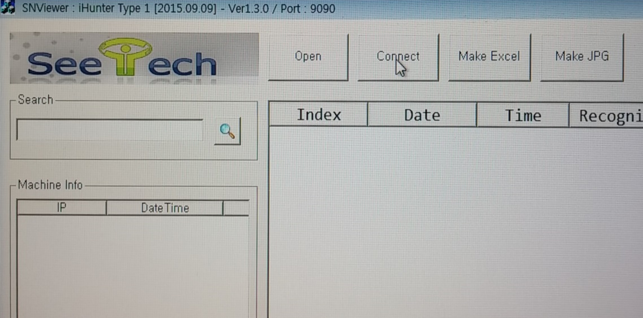
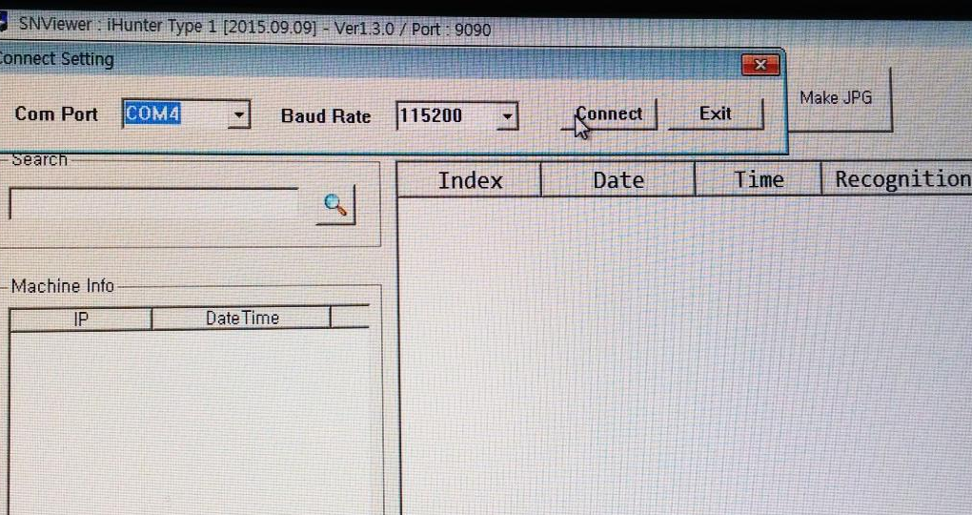
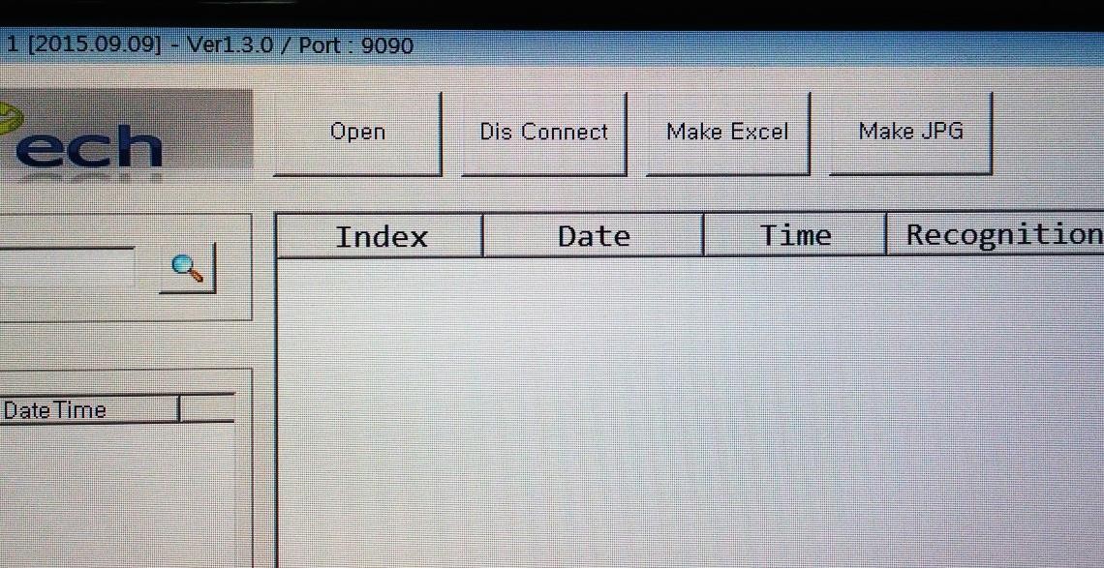
1. Execute SN Viewer Ver_1.3.0.
2. Click Connect.
3. Set Com Port and Baud Rate and click Connect.
4. When Connect is changed to Dis Connect, M150 is connected to SNViewer.

Slide 5
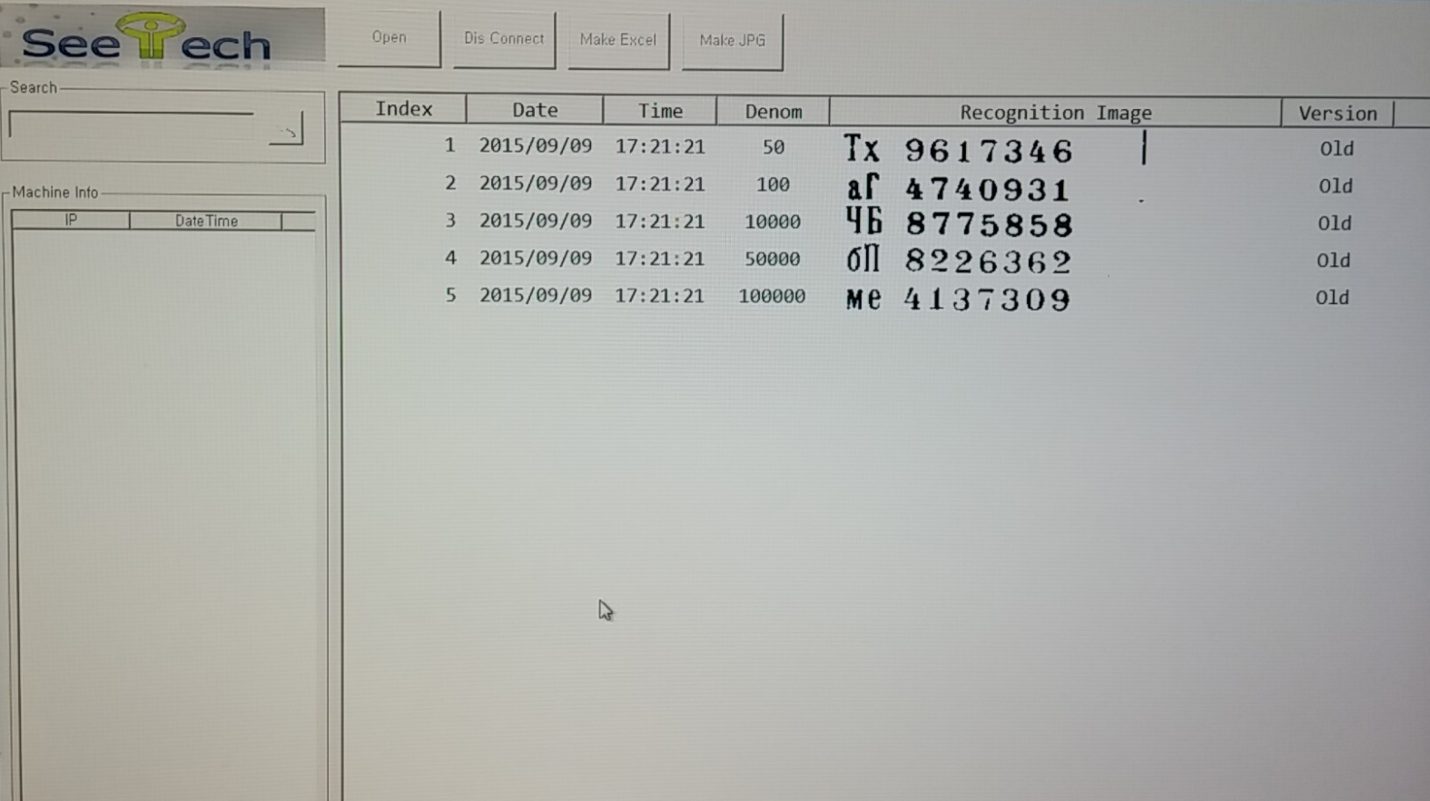
After Count BYR notes and remove notes from Stacker,
Serial Data is transferred to SNViewer as below.

